Slide 1
CS 4530 & CS 5500
Software Engineering
Lesson 12.2: Metrics in Software Engineering
Jonathan Bell, John Boyland, Mitch Wand
Khoury College of Computer Sciences © 2021, released under CC BY-SA

Slide 2
Learning Objectives for this Lesson
By the end of this lesson, you should be able to…
Recognize commonly used metrics in software development
Understand limitations and dangers of making development decisions based on metrics

Slide 3
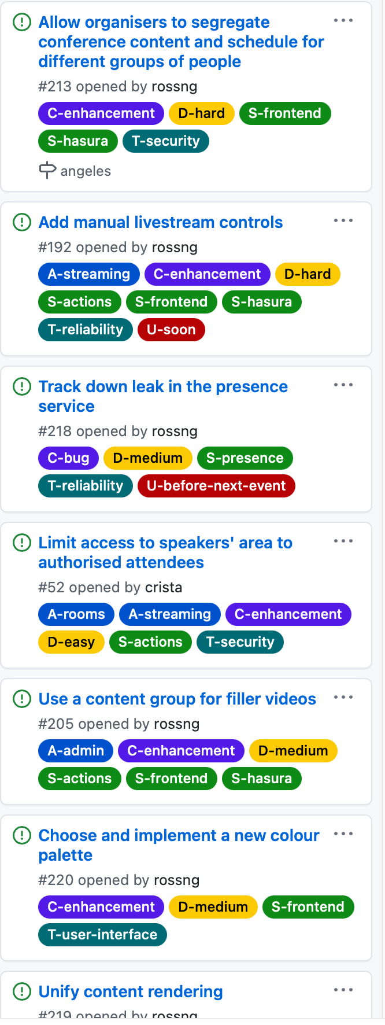
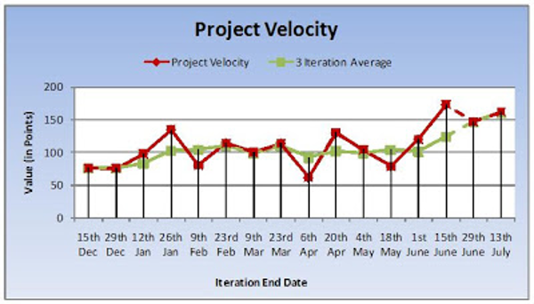
Tracking Development Progress
Sprint Velocity
∑ Story Points Completed
Sprint Velocity =
∑ Story Points Planned
Notes:
In the last lesson, we discussed how to schedule tasks into agile sprints. I mentioned that at the end of each sprint, you could reflect on your team’s performance over the last sprint in order to adjust your estimates.
Reflect on prior sprints: how much did we plan, how much did we do? Consider size of each task in terms of story points (or hours). Useful for checking progress and quality of estimations. Can use velocity over time to estimate future performance.
…What other metrics are available?

Slide 4

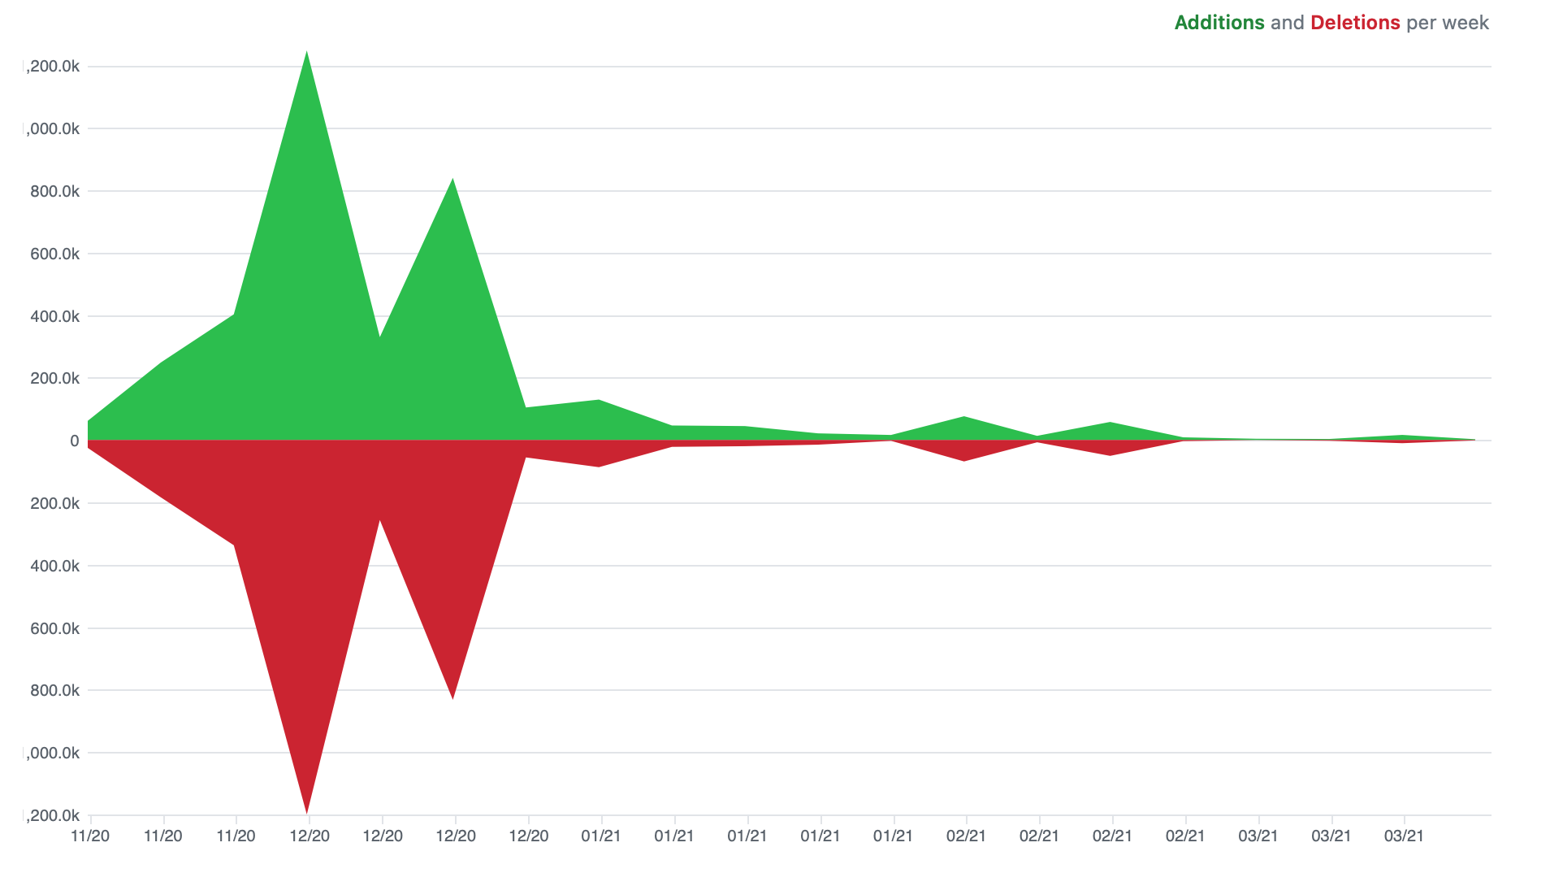
Tracking Development Progress
Metric: Lines of Code
Notes:
Easiest metric: volume of code (lines of code) - somewhat meaningless on its own, change over time might be interesting. Could also look at lines of code per-developer, or per-week

Slide 5
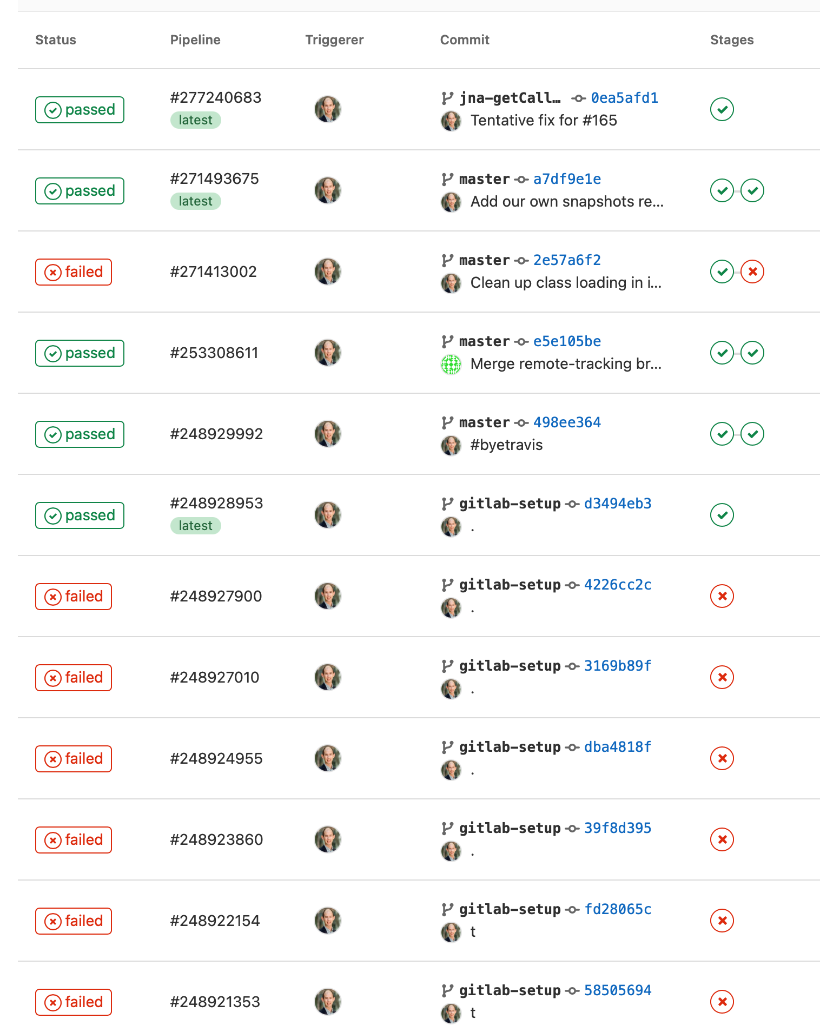
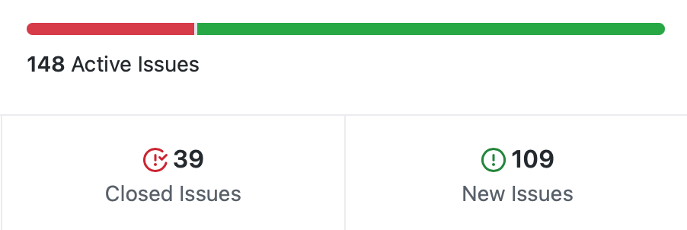
Tracking Development Progress
Metrics: Bugs open/closed, tests passing/failing
Notes:
We might also consider metrics that track code quality, like number of bugs opened and closed, or number of tests failing, linter errors, etc.

Slide 6
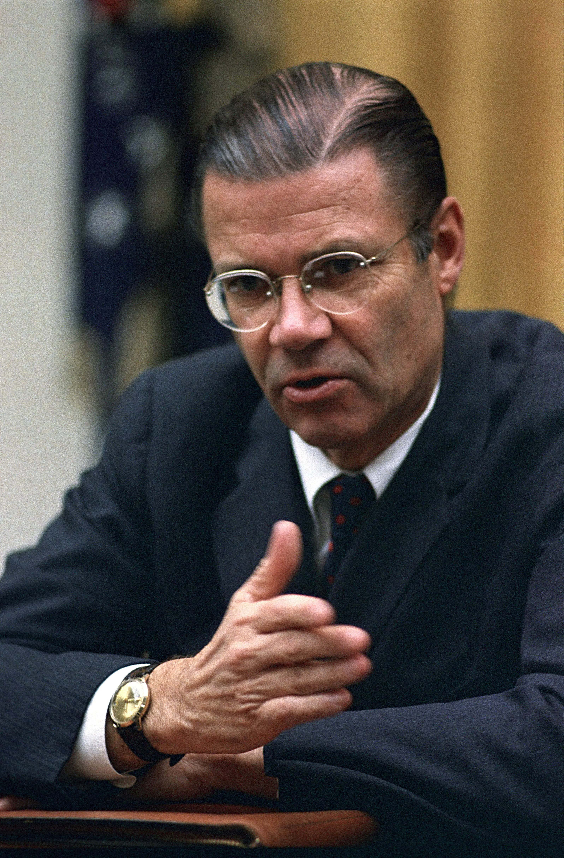
McNamara Fallacy
Reflecting on Vietnam decision making
Measure whatever can be easily measured
Disregard that which cannot be measured easily
Presume that which cannot be measured easily is not important
Presume that which cannot be measured easily does not exist
Notes:
When talking about quantitative metrics, it’s extremely important to consider how rigidly we follow them.
Robert McNamara was secdef in the 60’s, had previously been an executive at Ford where he made quantitative metrics for each phase of production and ruthlessly optimized to improve efficiency and production. Applied similar strategy to secdef… “Things you can count, you ought to count - loss of life is one” - so, based lots of strategy on body counts. Body count is one thing, but not the whole picture. After war ended in interviews, generals commented that body counts were misguided way to measure progress. Compare to: using LoC to track progress on a project… how do you even know how many lines there should be, and is it good to have a lot? Software metrics are very tricky because it it is hard to quantify everything.

Slide 7
Software Metric: McCabe Cyclomatic Complexity
Is this code complex to understand?
public static char[] percentDecode(char[] input) {
char[] result = new char[input.length - 2 * count(input, '%')];
int size = 0;
for(int i = 0; i < input.length; i++) {
if(input[i] == '%') {
result[size++] = hexToChar(input[i + 1], input[i + 2]);
i += 2;
} else {
result[size++] = input[i];
}
}
return result;
}
Input: “Hello%20World”
Output: “Hello World”
Notes:
Here is an example of McNamara fallacy in SE. Take a look at this method written in Java, which performs URL decoding - replacing a string represented by a URL encoded hex value with the regular ASCII character that is encoded. For instance, in the example shown, it replaces %20 with a space. Do you think that this method is complex? How do we even judge if a method is complex - it’s maybe a qualitative metric, right? One common goal with software engineering metrics is to create a quantitative metric to represent the complexity of code - if you could do that, then you could analyze your codebase, find the most complex code, and try to refactor it to be less complex, or at least, to ensure that it’s well-tested, since the most complex code might contain the most defects.

Slide 8
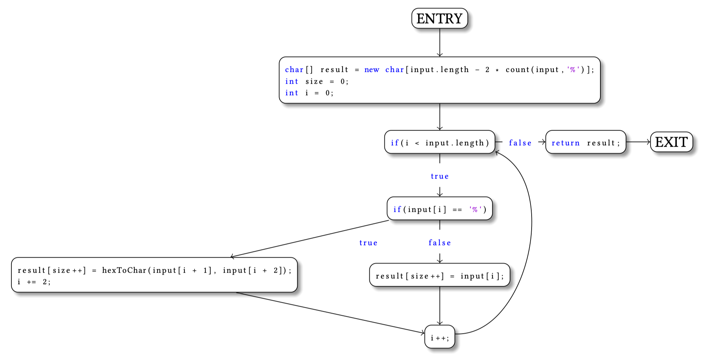
Software Metric: McCabe Cyclomatic Complexity
Is this code complex to understand?
M = E - N + 2P
M = 10 - 9 + 2•1
M = 3
Is this good?
Notes:
So, that’s exactly what McCabe’s chromatic complexity metric aims for. This metric is calculated by examining the control-flow graph for the method under analysis. I show here a control flow graph for this same percentDecode method from the last slide. The control flow graph has one node for each basic block in the program - each time that there’s a conditional branch (an if statement), this starts a new basic block. This complexity metric “M” is calculated as the number of edges in this graph, minus the number of nodes, plus two times the number of connected components. So, this graph has 10 edges, 9 nodes, and 1 connected component, yielding a complexity metric of 3. On its own, it’s hard to determine if this is a good function (simple or complex). It might be more useful in comparison to other functions - if you found others with values of say, 15-20, then perhaps they are more complex than this one. The original evidence for this approach was that “the complexity measure is designed to conform to our intuitive notion of complexity” - but no evidence that this correlates with other measures. Applied to this metric, the McNamara fallacy might make us skeptical of whether a quantitive metric Cyclomatic Complexity really measures what we might care about (if complex code has more bugs, or if complex code is harder to read).

Slide 9
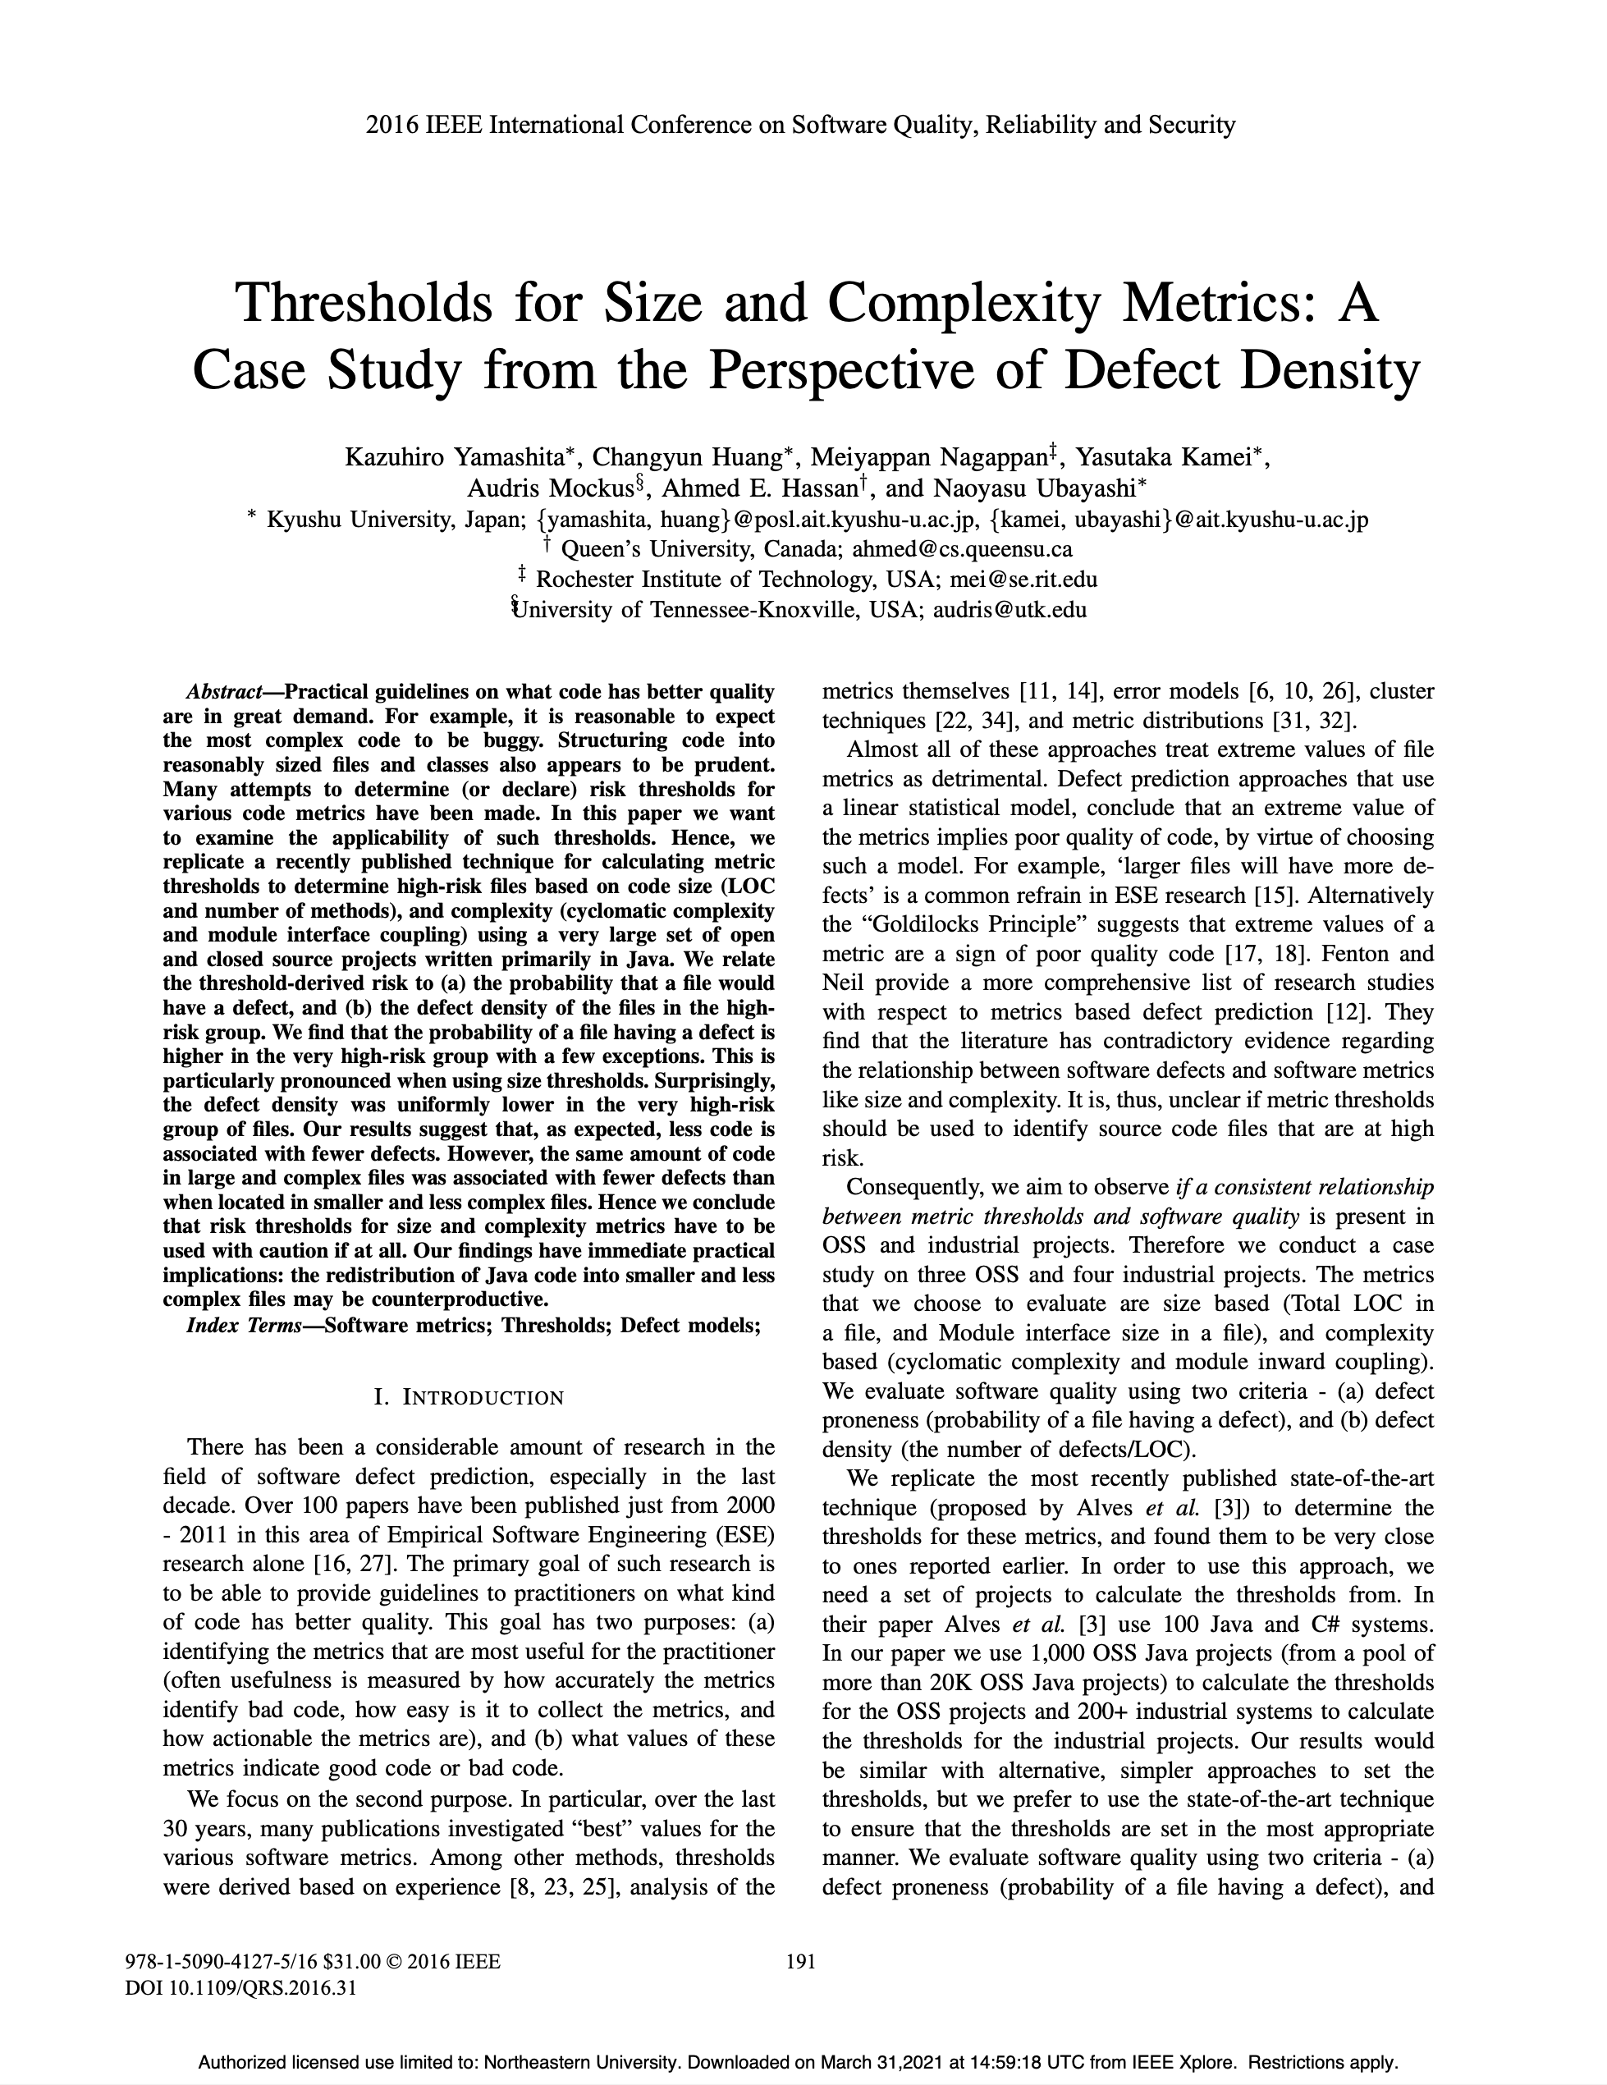
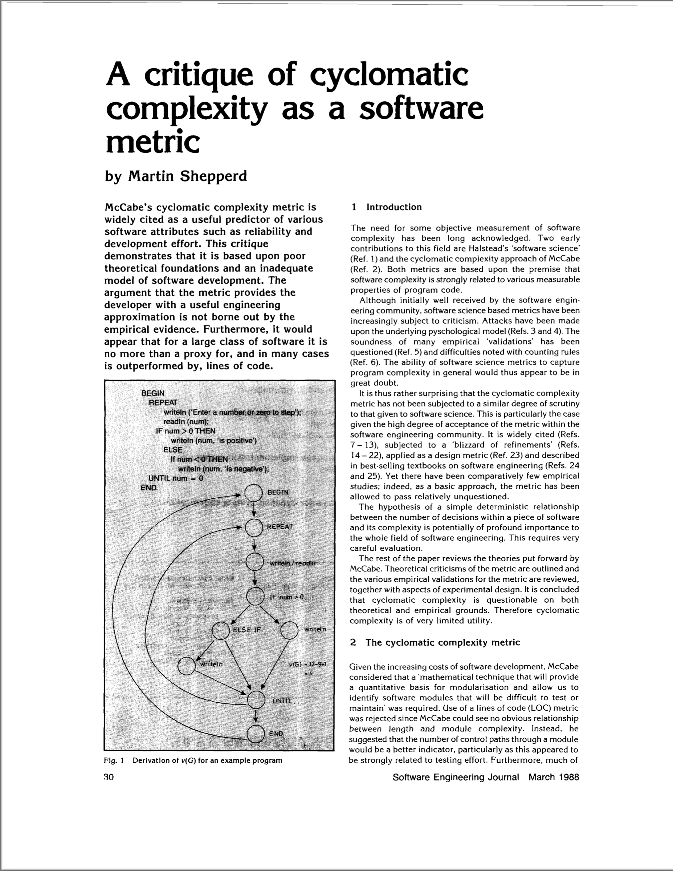
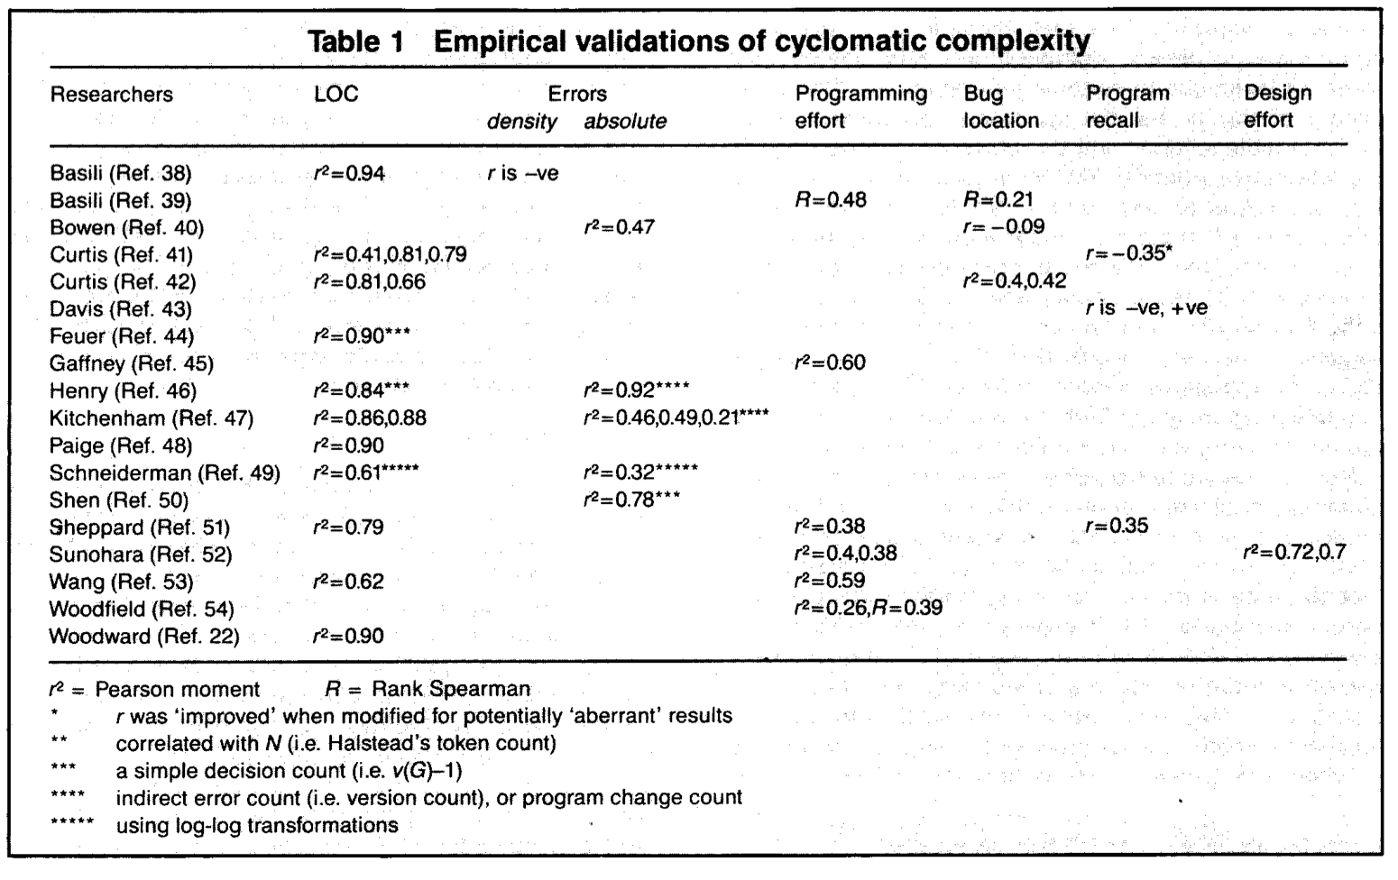
Software Metric: McCabe Cyclomatic Complexity
What does this value mean?
Notes:
Studies have investigated the correlation between Cyclomatic Complexity and error density, programming effort, program understanding, and design effort. There is very weak evidence that Cyclomatic Complexity correlates with any of those other measures. The strongest evidence for what Cyclomatic Complexity measures? Simple: lines fo code.
Recent studies have looked at defect density vs Cyclomatic complexity and found that there are more defects in complex code, but also more defects in bigger code files - shocker? Even more interesting, the authors found that “… the same amount of code in large and complex files was associated with fewer defects than when located in smaller and less complex files”. So, what have we learned? We should be skeptical of quantitative metrics that attempt to capture complex quality attributes of software (and, honestly, most things in life).

Slide 10
Goodhart’s Law
When a measure becomes a target, it ceases to be a good measure
Dilbert © 2021, Andrews McMeel Syndication
Notes:
Another significant risk when applying metrics in software engineering arises when we try to use a metric as a target for our team. Goodhart’s law says that when a measure becomes an actual target, it ceases to be a good measure, because the people you are measuring will change their behavior to optimize for that metric (at the expense of other metrics that you are not tracking). For instance: you could imagine that when giving developers a bonus for each bug that they find and fix, this could degrade into developers introducing bugs just so that they can find them and get a bonus.

Slide 11

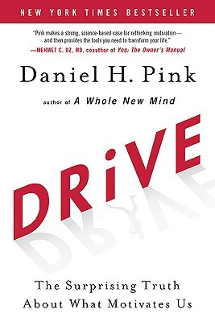


Productivity Metrics
Intrinsic & Extrinsic Motivations
Extrinsic rewards:
Can extinguish intrinsic motivation
Can diminish performance
Can crush creativity
Can crowd out good behavior
Can encourage cheating, shortcuts, and unethical behavior
Can become addictive
Can foster short-term thinking
Focus on encouraging:
Autonomy
Mastery
Purpose
Notes:
Instead, if you find yourself in a position of management, most literature suggests against incentivizing productivity based on particular metrics like this. Instead it’s best to focus on working with employee’s personal motivations, rather than creating artificial, extrinsic motivators. In addition to driving behavior that you don’t want (like developers who introduce bugs just to fix them), creating these extrinsic rewards and measures behind them can be demoralizing and demotivating to your employees who are actually interested in doing a good job.
In the next lesson, we’ll discuss how to be an effective team player, qualitatively, and set metrics aside for a short time

Slide 12
This work is licensed under a Creative Commons Attribution-ShareAlike license
This work is licensed under the Creative Commons Attribution-ShareAlike 4.0 International License. To view a copy of this license, visit http://creativecommons.org/licenses/by-sa/4.0/
You are free to:
Share — copy and redistribute the material in any medium or format
Adapt — remix, transform, and build upon the material
for any purpose, even commercially.
Under the following terms:
Attribution — You must give appropriate credit, provide a link to the license, and indicate if changes were made. You may do so in any reasonable manner, but not in any way that suggests the licensor endorses you or your use.
ShareAlike — If you remix, transform, or build upon the material, you must distribute your contributions under the same license as the original.
No additional restrictions — You may not apply legal terms or technological measures that legally restrict others from doing anything the license permits.

